Slide 1
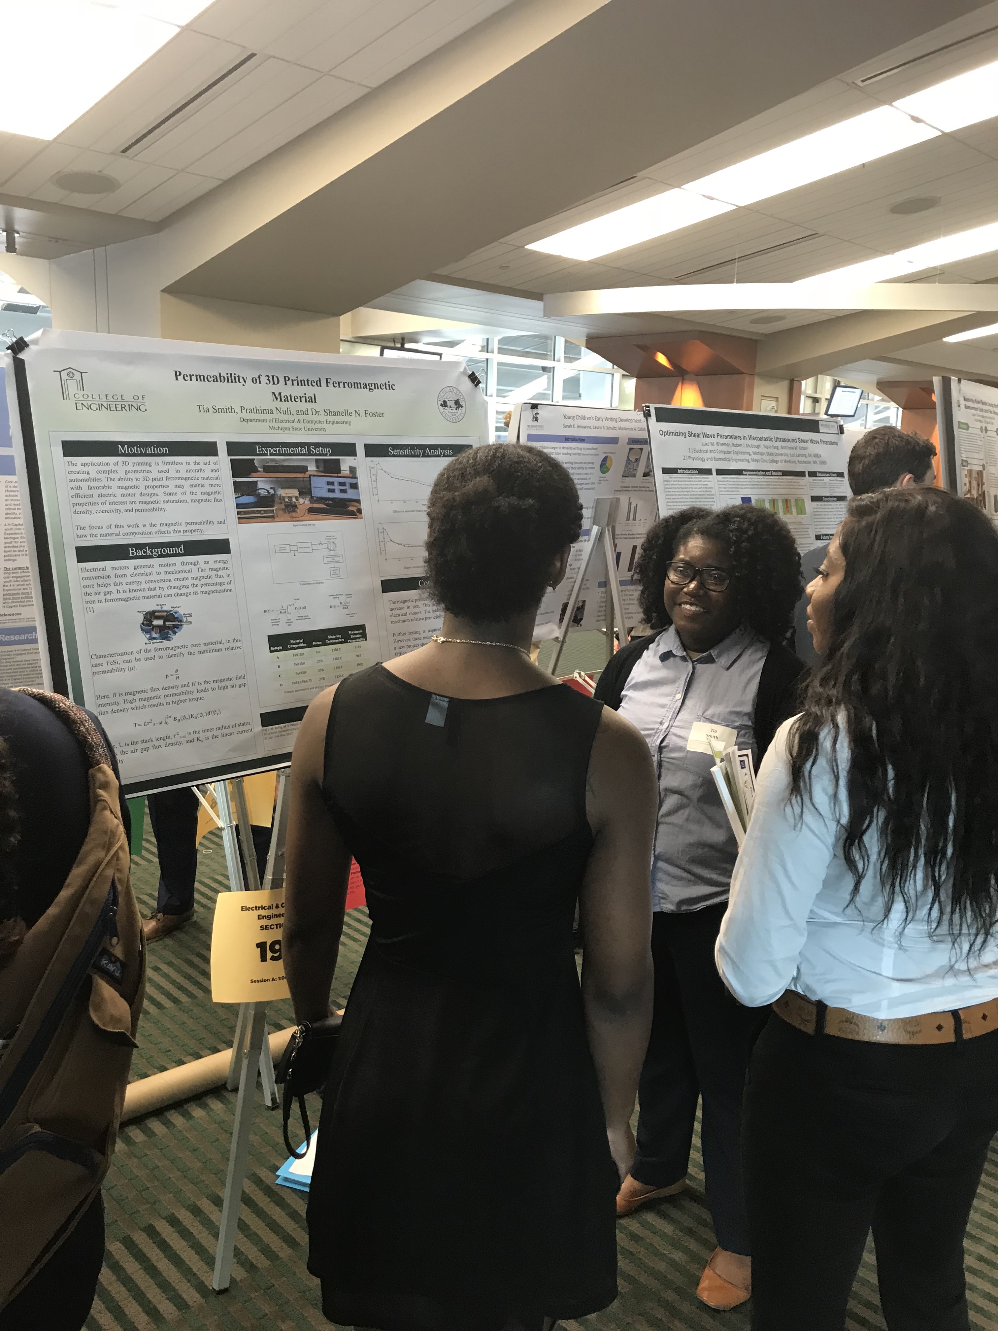
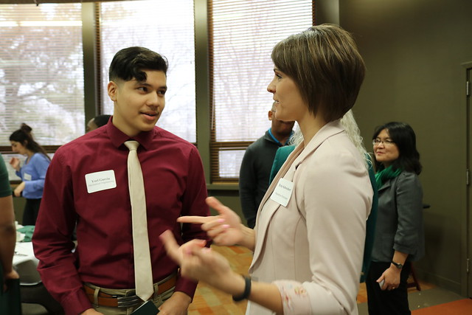
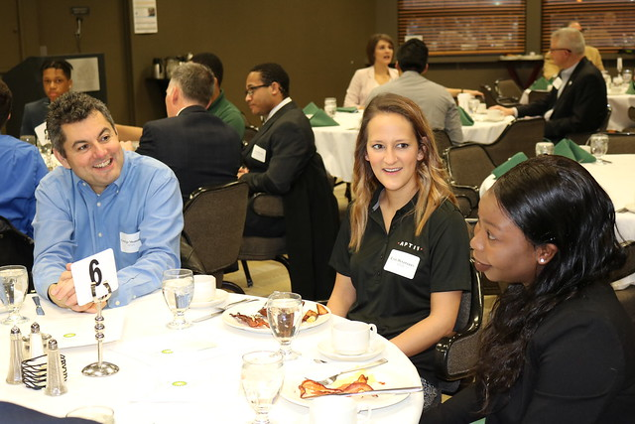
The Diversity Programs Office
A Student Support Office Focused on Academic and Professional Development
Kyle P. Foster (fosterky@msu.edu), MEng. – Director

Slide 2
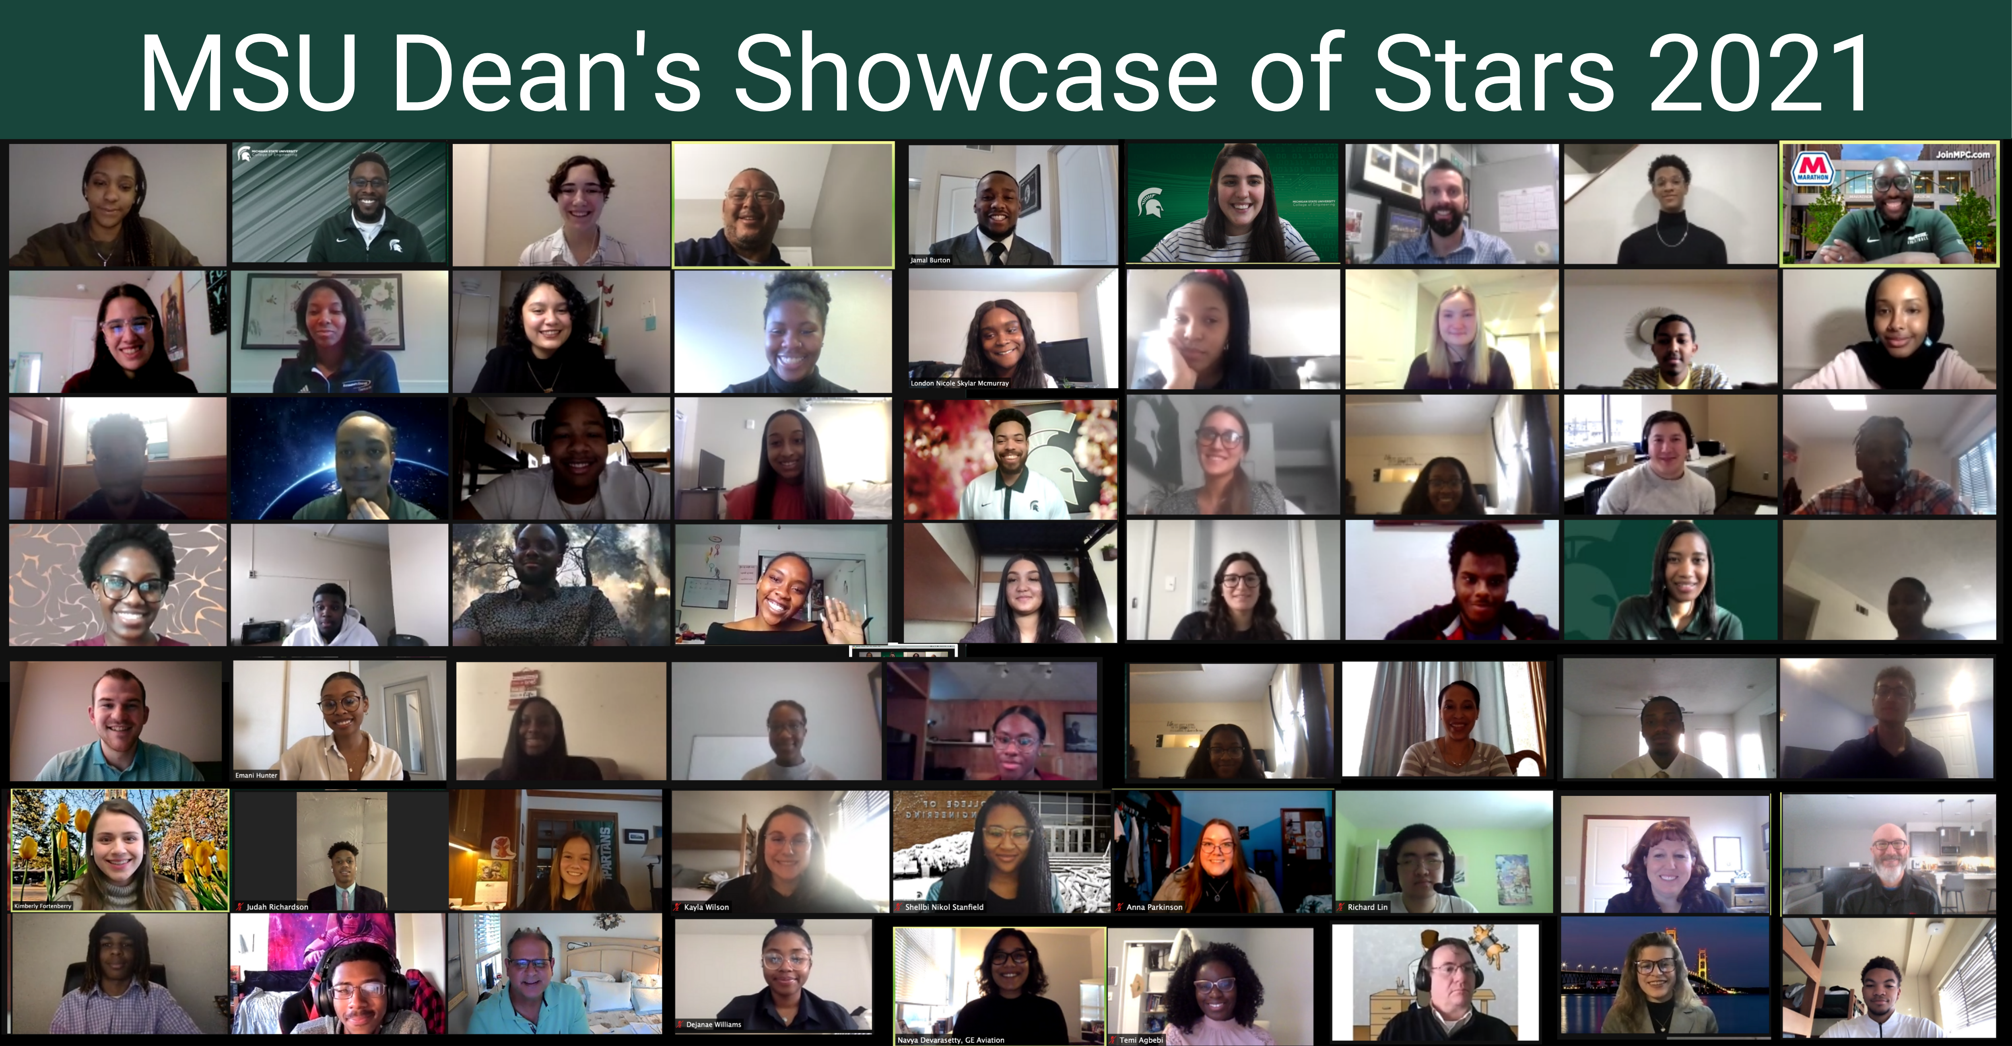
DPO Operations
Mission: To help recruit and retain a diverse set of students in the College of Engineering
Historical Target Audience: Underrepresented Minorities (URMs), First-Gen, High-Financial Need. (All programming is inclusive)
DPO Programming
Michigan Louis Stokes Alliance for Minority Participation (MI-LSAMP)
Summer Undergraduate Research Opportunities
Freshmen Engineering Seminar Course (EGR 160)
Dean’s Showcase of Stars
Guided Learning Center (GLC)
Student Success Coaching
Registered Student Organizations

